Slide 1
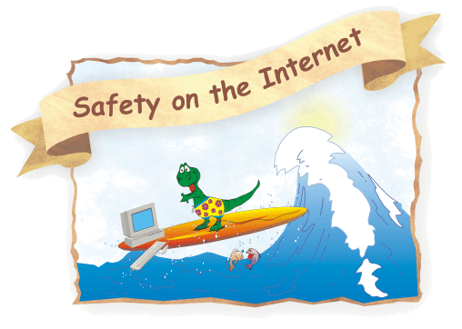
“DO THE RIGHT THING”
Feel safe
Keep it safe

Slide 2
Safe internet short guide
Netiquette
Copyright /Data Protection
Better Internet for students
Ε-Safety & other resources

Slide 3
Netiquette
Codes of behaviour =
common-sense rules, good manners and other good practises
communicating online
miss very important pieces of information, (tone of voice, gestures, etc).
Misunderstanding/ taking words out of context.

Slide 4
Copyright and Data Protection

Slide 5
The Internet
a space for sharing and exchanging
But
When and How can you use material found on the Internet?
Can you use copyrighted music when creating a video/presentation?
Can you use pictures found on the web without a second thought?
Lost with copyright issues ?
Take a look at the following website by Childnet International.
http://www.childnet.com/resources/downloading/home

Slide 6
Protects
Enables
informs
Notes:
protects the creator
Enables to control the use of material
informs who can copy/adapt /distribute work and
when

Slide 7
What can the user do? Attribution
TASL
1. Title – What is the name of the material?
2. Author - Who owns the material
3. Source – Where can I find it?
3. License – What specific license is the work is under?
Notes:
Terms get usually modified

Slide 8
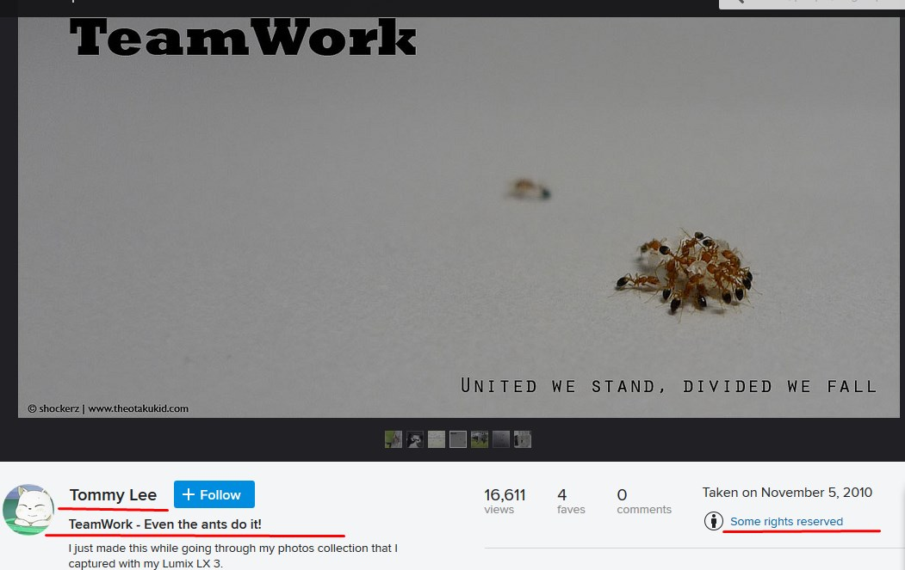
Attribution- how to

Slide 9
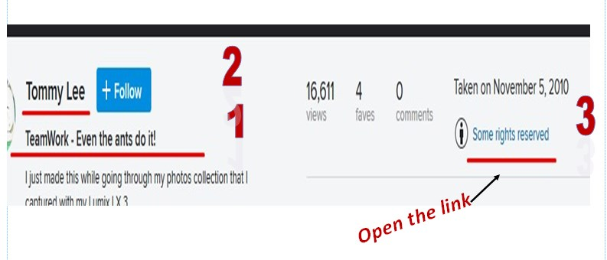
Title
Author
License

Slide 10
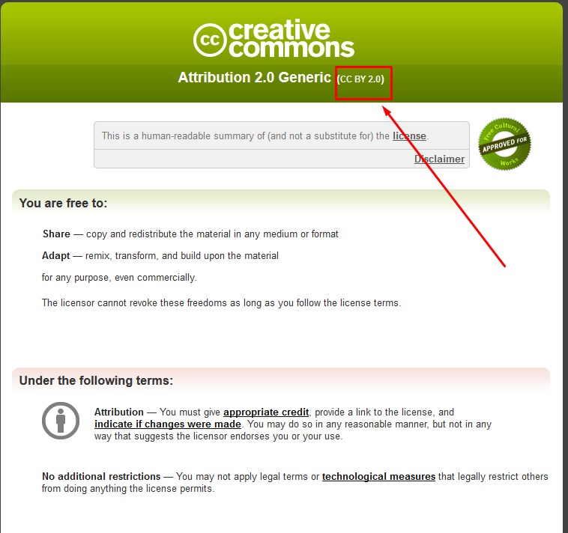
"TeamWork - Even the ants do it!" by Shockerz Lee (CC BY 2.0)

Slide 11
What can the creator do? Creative Commons
Protects creators
Enables sharing/use

Slide 12
CC: What is it?
A nonprofit organization
that enables sharing and use of materials and resources
through free legal tools.
Learn more about
the licensing types/ and what they mean.
the tool/ to choose the type of license you need.

Slide 13
How?
visit https://creativecommons.org/licenses/
choose https://creativecommons.org/choose/
download or embed

Slide 14
Better Internet for students

Slide 15
Help your students
Discuss about the personal info to be uploaded
No addresses/phone numbers
Ask parents’ written permission for students’ profile photo
Urge them to report insulting posts/ messages/ bullying or abuse
Show them how to delete them
Teach netiquette for their mailbox communication

Slide 16
Protect your students and... yourself
Ask parent’s written permition for
student’s participation in projects when
student’s photos may be uploaded on Internet
Get students’ faces blurred

Slide 17
Copyright free!
http://incompetech.com/
http://search.creativecommons.org/
http://foter.com/
https://unsplash.com/
https://pixabay.com/
http://www.freedigitalphotos.net/
http://www.teachertrainingvideos.com/googleimages/index.html
how you can search for copyright free photos in Google by Russell Stannard

Slide 18
Other resources about e-Safety
Better Internet for Kids
https://www.betterinternetforkids.eu/web/portal/policy/better-internet
Web We Want
http://www.webwewant.eu/
eSafety Label
http://www.esafetylabel.eu/web/guest
Safer Internet Day
https://www.saferinternetday.org/web/sid/home

Slide 19
“DO THE RIGHT THING”
Glykeria Gouvatsou, Greece

