Slide 1
Gamify Your Message
Kahoot!

Slide 2
Gamification
What is it?
applying game mechanics to non-game situations (education, advertising)
referred to as "funware" in marketing
Its goal
to generate enthusiasm and
to guide user behaviour
Marketing strategy:
Funware has the potential to change all of advertising.

Slide 3
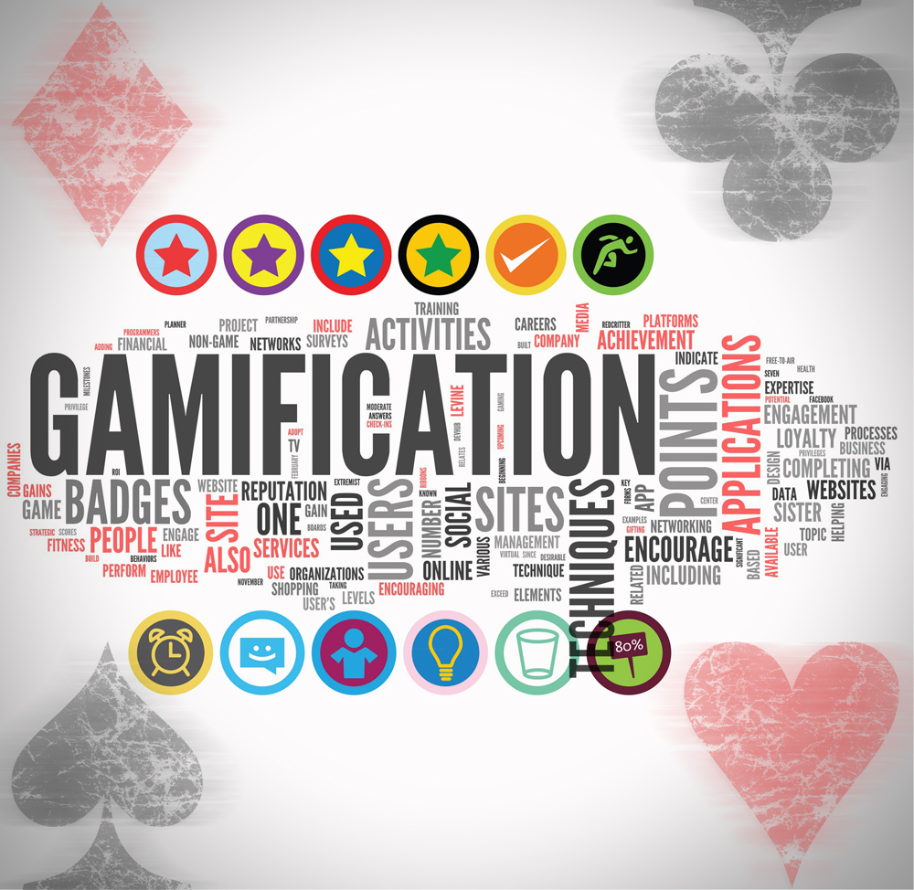
In Education
If you turn a school assignment into a game-like competition → kids will become engaged with it.

Slide 4
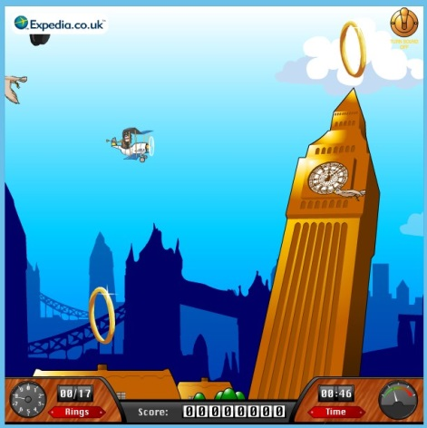
In Marketing
NEW
If you turn work into game → people willingly do it.
If you add a rewards-based loyalty program to your product → people will choose it over rivals.
The time has come to “game-ify” all boring industries so that users will be motivated to use products and services because they want to, not because they have to. (Game based marketing)
Gabe Zichermann, chief executive of beamME

Slide 5
Transliteracy = “trans” (across)+ "literacy
“the ability to understand and communicate
the ability to read, write and interact
transliteracy
across all communication of platforms, tools and Media.”
Sue Thomas, Chris Joseph (wikipedia)
media literacy
digital literacy
information literacy
signing
speaking
handwriting
print
TV
Film
digital media
Social media
a move to unify media and all literacies relevant to reading, writing, interaction and culture, both past and present.
Notes:
meaning to write or print a letter or word using the closest corresponding letters of a different alphabet or language....
transliteracy extends the act of transliteration and applies it to the increasingly wide range of communication platforms and tools at our disposal.

Slide 6
Gamification-usage
a powerful medium
a Communication
tool
To teach
To persuade
To motivate
To engage
To create excitement
To educate immersing in your message
To spark creativity

Slide 7
Gamification-benefits
Communicating
Sharing info/ calling to action
Conveying messages (objectives and the best way to achieve them).
learning
Not doing well on a game is not failure in a gamified world. It is the gateway into learning.

Slide 8
Gamification motivators
Competition: How can I be better than others?
Mastery: How good can I be at this?
Learning: How can I elevate my knowledge?
Achievement: How will I feel to win again?
Status: How good will I look after winning?
Sociability: How can I connect more closely with my team?
Partnership: How can I contribute to my team improvement?

Slide 9
How does it work?
content
or
message
even if complex
Stickier
through the use of gaming techniques
gets
When it also educates audience
about the latest information
it’s a win/win
Notes:
Ex. You may not want to watch an ad again but you will want to play a game again even with with the same content.

Slide 10
Why is gamification effective?
Games
Consist a basic need
encourage ongoing engagement
are
social
functional
pleasurable
meaningful
Games
EVOLUTION: Games are motivation engines

Slide 11
Gamification
Gabe Zichermann
mm
Phychology
75%
Technology
25%

Slide 12
Gamifying your message
Consider
1. Why do you want to gamify?
2. Who is your target?
3. What are your goals/objectives/desired outcomes?
4. Have you mapped any necessary skills /actions?

Slide 13
Important!
Keep your Gamification mechanics:
Simple to understand
short
specific

Slide 14
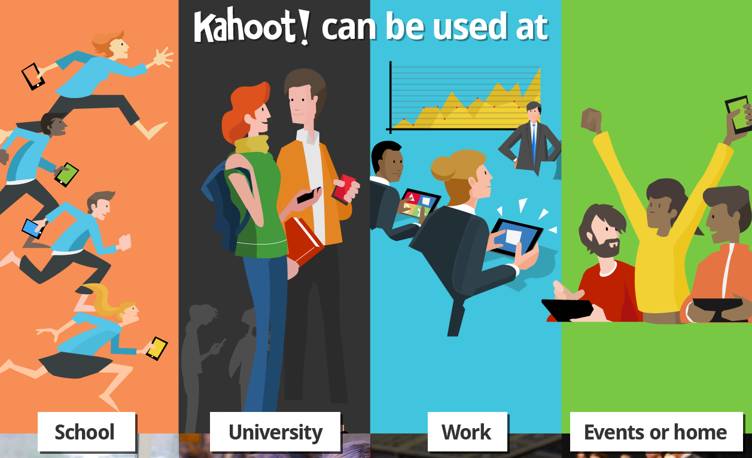
The tool: Kahoot!

Slide 15
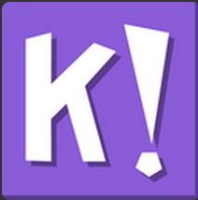
what is it?
A game-based blended learning platform
An interaction quiz game
allows users to
research
Create
collaborate
share knowledge
Convey messages
“The tool that gives the user a voice”

Slide 16
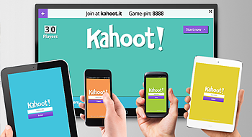
pros
it is
simple.
easy to use
available for free
engaging
motivating
not time demanding
fun for all ages
accessible by any device (with a web browser and Internet connection)
has its own Community.
lets you export the results and analyze data
sharable – in person, at events , across social media
Notes:
also customize other users Kahoots if you'd like to add or remove questions

Slide 17
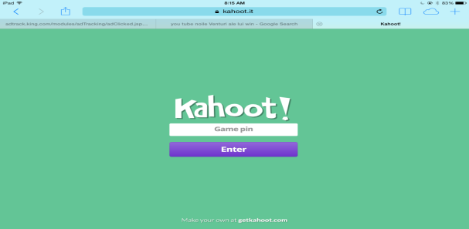
The audience/target
schools
business.
anyone to share info in the same room,
or in the web.
discover
Create
play
on any subject,
language
age

Slide 18
Who can use it?
Anyone who wants to:
introduce new topics
increase retention of new facts
revise prior to exams
challenge audience around the world
survey opinions
gather insights
facilitate discussion
reward and re-energize target players.

Slide 19
Designing your own quiz Step 1: Why?
CRITICAL QUESTIONS:
Why to gamify your info/findings/product?
Does it benefit the users?
Will they enjoy it?
BUSINESS QUESTIONS:
What are the goals?
How do you get the users to fulfill those goals?
What actions do you want your players to take?

Slide 20
Step 2: User Profile
Consider:
Who are your players?
What are their needs and goals?
Why are they playing?
Who are they playing with?
What social actions do they find enjoyable and why?
What metrics do they care about?

Slide 21
Step 3: The questions
“Great Learning starts by Asking Great Questions”
says Kahoot
Consider:
NOT ONLY the correct answers,
but also
the potential incorrect answers.

Slide 22
Step 4: play & test
Test it - play - make corrections
What's working / What isn't?
What have you not considered?
Is it tailored to the target players’ needs?
Is it going to be interesting in 3 months time?

Slide 23
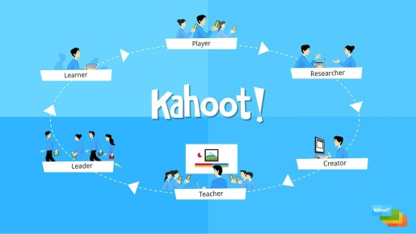
Design your own quiz
Start from here: https://getkahoot.com/ Guide: https://getkahoot.com/tutorials/Kahoot_Tutorials.pdf

Slide 24
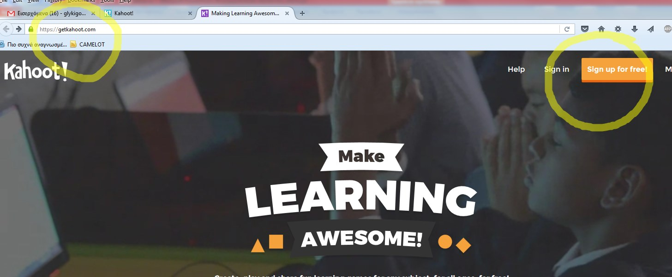
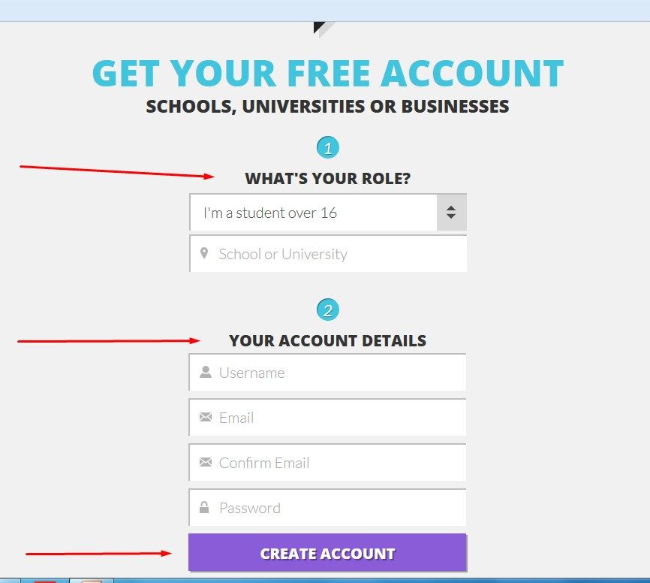
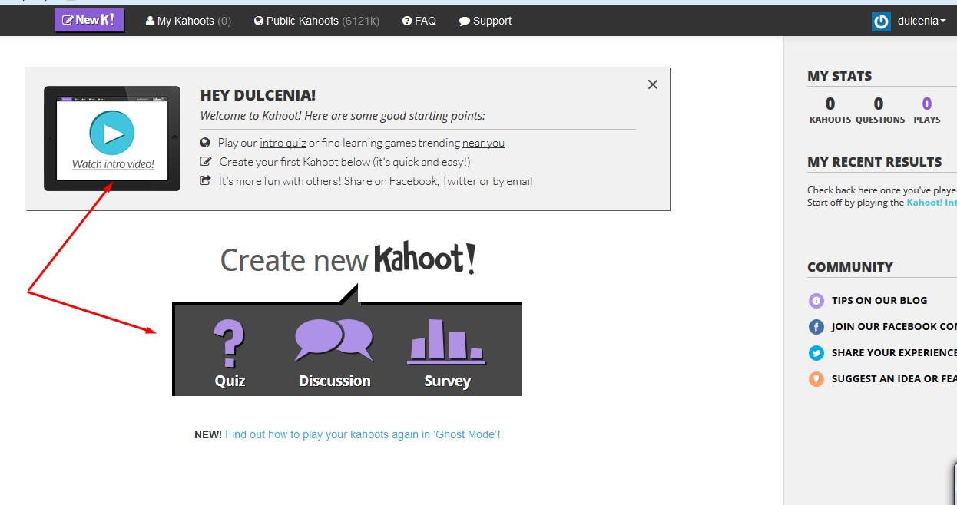

Slide 25
references
http://edtechreview.in/news/586-kahoot-game-based-classroom-engagement-tool
Entertainment Software Rating Board
http://www.wired.co.uk/news/archive/2015-06/23/kahoot-gaming-education-platform-norway
http://www.fractuslearning.com/2015/04/20/gamify-your-classroom-kahoot/
http://www.mindcet.org/en/what-do-teachers-want-kahoots-secret-of-success
http://venturebeat.com/2010/03/30/game-based-marketing-takes-off-from-frequent-flyer-programs-to-social-media/
credits
Pictures taken from https://getkahoot.com/

Slide 26
MEDIA EDUCATION: From passive consumers to active creators

