Slide 1
PHOTO ESSAY GUIDELINES

Slide 2
PHOTO ESSAY
A photo story is a story told through images often accompanied by text captions
A photo essay/story should be able to stand alone without written words and make logical sense to the viewer. However, it can include captions if you decide so.
Much the same as a written story, photo stories should have a setting, plot, and characters.

Slide 3
Main features of a good photo essay
It has an engaging and thought provoking story
It engages viewers emotionally
It includes both informational and emotional photos
The pictures are arranged in a sequence that supports the telling of the story
It shows deep understanding of the subject

Slide 4
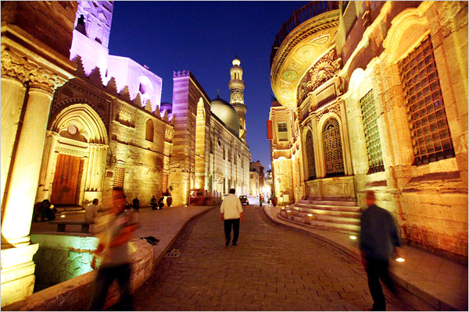
OVERALL or SCENE PHOTO
A scene setter or a wide angle picture that establishes the location or setting of the story subject.
Places your viewers in the action by taking a photo that shows it all.
Allows your viewers to understand the rest of the story in a geographic context.
Examples: if the story is about the effects of a hurricane on a small town, the overall can be an aerial photograph of the vast, destroyed landscape.
“Cairo Aglow at Ramadan” Photo: Shawn Baldwin for The New York Times

Slide 5
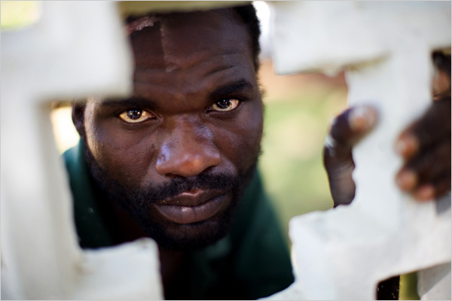
PORTRAIT PHOTO
The subject of your story, especially in repeated identity stories.
Your photo essay should include at least one portrait photo.
It can be a tight head shot or a wider shot that shows the person´s surroundings relevant to the story.
“In South Africa, a Resurfacing of Violence” Photo: Robin Hammond for The New York Times

Slide 6
DETAIL PHOTO
It´s an informative, close-up picture of a relevant object, or subject feature, that should educate the viewer or reveal something unknown about the story´s subject and should highlight a specific element of the story
They can have great storytelling potential on their own because they do a great deal to dramatize a story.
Examples: the weavers hands or a sample of a rug or the bowls in which the dies are mixed, books on a desk etc.
“High-Speed Connections” Photo: Laura Pedrick for The New York Times

Slide 7
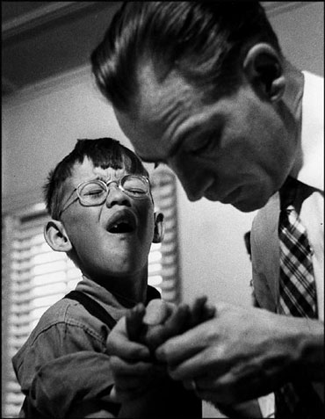
ACTION PHOTO
Should illustrate your subject´s human interaction with others, daily activities, occupation, or athleticism.
Helps to give a human dimension to your character and add movement to your story
Examples: a doctor doing surgery, an artist working on his painting, a singer singing etc.
Colorado, 1948. Dr Ceriani looking at a 7 year old boy´s injured hand by W. Eugene Smith/Magnum Photos

Slide 8
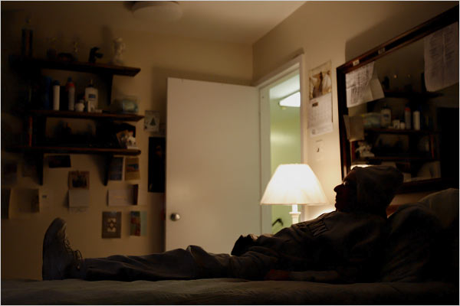
CLINCHER PHOTO
or final image, is a picture that settles or resolves the story´s conflict.
Should evoke the emotion you want the viewer to walk away with.
Examples: a picture of a new mother embracing her baby right after birth, a soldier´s farewell salute to fallen comrades etc.
Remembering Hardware” Photo: Ruth Fremson/The New York Times

Slide 9
Materials used:
Keith Jenkins: „5 types of photos that make for strong photo essays, audio slideshows“ available at www. poynter.org
Stacy PearsalI: A Photojournalist´s Field Guide: In the trenches with combat photographer, SBN-13: 978-0321896612
CUNY Graduate School of Journalism at http://photo.journalism.cuny.edu/week-5/
Matt Brandon: The photo essay: Give it your best shot at www.digitaltrekker.com

