Slide 1
QR CODES
Notes:
marketers will slap a QR code on anything that doesn't move or talk. What’s that weird blocky thing?

Slide 2
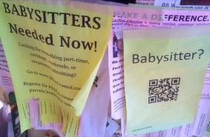
QR Codes in our lives
photo credit: Ed and Eddie via Flickr cc by-sa 2.0
https://www.youtube.com/watch?v=tGYqxVrJN-s

Slide 3
What is a QR code?
Quick Response code
QR code
2D code, matrix code
black modules (pixels/square dots)
arranged in a square grid on a (usually) white background
consists of
Comes from
Japan

Slide 4
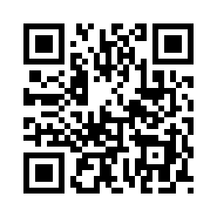
Its Use
As
an optical machine
A tool to save data in encoded form
a readable label on objects
containing information about the object

Slide 5
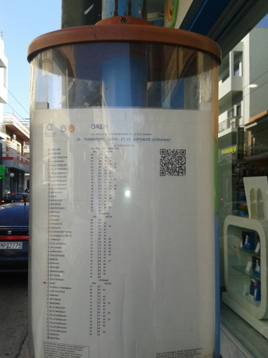
Places Where You Can Find QR Codes
.
t-shirts/hats/clothing
stickers
tattoos
movie posters
artwork
plastic bottles/cups
Disney
Classrooms/worksheets
webpages
business cards
baking
restaurants
stores
businesses
real estate signs
tombstones
museums
libraries
advertisement flyers
ads in magazines
informational handouts
insurance companies
and other businesses

Slide 6
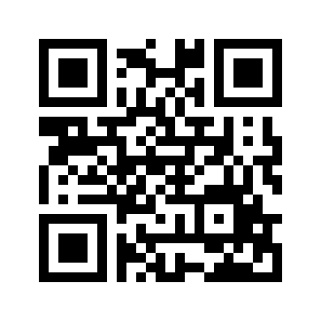
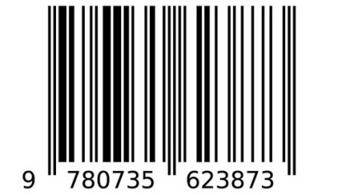
QR code Versus barcode
No data
data
data
data

Slide 7
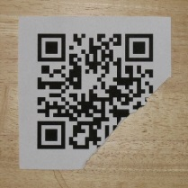
QR code barcode
2-dimensional
(vertical and horizontal).
Consists of modules (pixels)
can store more than 5,000 alphanumeric characters/7000 digits in a limited space.
No need of a beam to be read
also readable even if 30% of it is damaged
1 dimensional-linear
(e.g. horizontally from left to right)
Consists of bars
Usually stores up to 30 characters/just numbers
Needs a (green) beam to be read
unreadable if it has a little dot on it

Slide 8
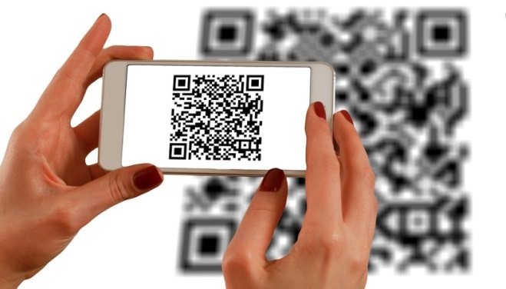
QR code data variety
Telephone number (Phone call)
SMS/MMS message
Email (Send message)
Text
Hyperlink
Contact entry
Calendar entry
Image
Notes:
What can QR codes link to?

Slide 9
Advantages
more information in less space
bridge the gap between the traditional offline marketing, and the online world
captivate viewers with dynamic, engaging content
store and present URL including pages, geo coordinates, text information, social media properties, even mailing addresses
readable by anyone with a smart phone and a QR code reader application
.

Slide 10
More Advantages
Convenient: provide one-step process
Environmentally-Friendly: efficient use of printed materials and waste reduction.
Cost-Effective: cost nothing to produce.
Adaptable: integrated with a wide range of marketing materials for any purpose ( print material, outdoor display, direct mail etc).
Device Independent: viewed on all smartphone models, no need of special development for different platforms.
Measurable: Actions triggered can be traced with web analytics for marketing campaign measurement.
Competitively different: lead in strategic marketing.

Slide 11
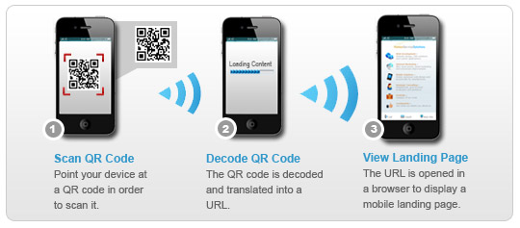
How does a QR Code Work?
It is canned with a mobile device -iPhone and Android (equipped with a camera and QR Code reader application).
it is translated into information (a text message, mobile, web page, coupons etc).

Slide 12
Functionality
When the QR code is scanned the encoded information leads to
a range of actions on the user's device:
Display/View a Website or Landing Page
Dial phone Number
Send a Text Message
Send an Email
Launch a service
View a Message or Special Offer
Download Contact Details (VCARD)
Display a Google Maps Location
Link to a Social Media Profile

Slide 13
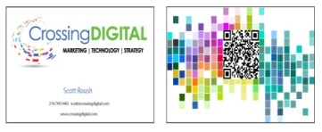
What Types of Organizations Can Use QR Codes?
Any type of organization in their marketing materials.
retail business
nonprofit organizations
associations
educational institutions

Slide 14
QR codes in Marketing
On business cards : business name ,address, website, blog, links.
in print advertising: link to product videos, or “Buy Now” pages.
In Campaigns: to increase social following- links to Facebook/Twitter/ LinkedIn.
On product packaging: links to a page with useful resources –service phone numbers, user manuals.
On event tickets: links to a Google map, and RSVP page, materials to be brought.
Notes:
a URL specific to the QR code in the ad with a re-direct is a great way to track how much traffic came to that page through your print advertisement.

Slide 15
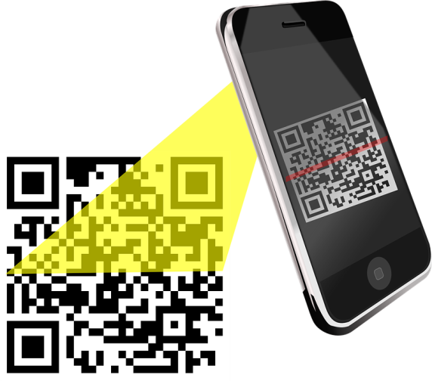
How does the cell phone read the code?
The cell phone needs a QR code reader, like this one from Kaywa. It takes literally 1 minute for someone with an iPhone or Android phone to find and install the reader.

Slide 16
Run a QR code campaign
You’ll need :
A QR code reader (Mobile app)
A QR code generator (Website service)
A QR code management/tracking tool (Website service) >>> optional
Generators:
Choose a generator based on the options for:
Code Format (i.e. QR, EZcode, Tag, etc.)
Stored Data (i.e. hyperlink, meCard, SMS, etc.)
Output (i.e. color, size, download file type, etc.)

Slide 17
How to read QR Codes
QR Code Readers
For non smart phone users
download the software via PC,
Transfer it,
install it to your phone.
Visit the website via its browser,
direct download,
install it.
For smart phone users
(iPhone or Android)

Slide 18
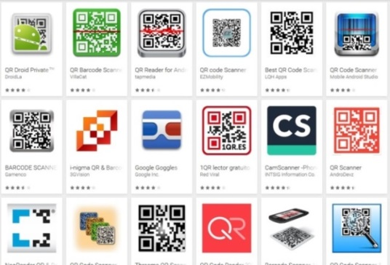
Desktop QR Code Software & Applications
Leadtools Barcode
QRreader
Bar Capture
Mobile Barcoder Firefox add-on
QR-Code Tag - Google Chrome
ScanLife For IE - Internet Explorer
QR Coder 2010 - QR code add-in
Barcode Maker 2D Adobe InDesign
Wordpress QR Code Plug-InJoomla QR Code Extension

Slide 19
Android QR Reader Apps
KAYWA: http://reader.kaywa.com/getit
i-nigma: http://www.i-nigma.com/Downloadi-nigmaReader.html
Lynkee Reader: http://m.lynkee.com/
UpCode: http://www.upc.fi/en/upcode/download/
QuickMark: http://www.quickmark.com.tw/En/memlogin/login.asp
SnapMaze: http://www.snapmaze.com/?q=node/7
BeeTagg: http://www.beetagg.com/downloadreader/
NeoReader: http://www.neoreader.com/get-neoreader/wap-download
NokiaReader: http://nds1.nokia.com//NOKIA_COM_1/Microsites/BetaLabs/applications/apps/Nokia_Barcode_Reader_S60_32.sis
bliQR QR Code scanner for iPhone:
https://itunes.apple.com/us/app/bliqr/id557663732?mt=8
GetTheReader: http://code.google.com/p/zxing/wiki/GetTheReader
QR Code Reader
Barcode Generator/Reader
ScanLife Barcode Reader
QR Droid
Barcode Scanner
mobiScan QR
https://play.google.com/store/search?q=qr%20code%20scanner&c=apps

Slide 20
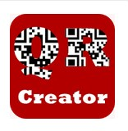
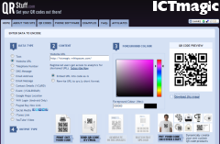
How to generate a code
using a site or Open Source code
Kaywa.com
http://www.waspbarcode.com/qr-code-generator
http://createqrcode.appspot.com/
http://www.qrcode-monkey.com/
Qurify.com
http://www.visualead.com/ watch demo
https://bitly.com/ write a URL address, click "Shorten," and add .qr to the end of the generated bit.ly link, copy the modified bit.ly link into a new browser window, get your QR code. How to Create a QR Code with Bitly https://youtu.be/x35uQM5jsh0
https://play.google.com/store/search?q=QR%20Code%20Generator&c=apps
And for more creative users:
https://www.unitag.io/qrcode http://www.qrstuff.com/
http://www.beautifulqrcodes.com/
http://www.unitaglive.com/qrcode
http://www.visualead.com/

Slide 21
Management & Tracking Tools :
to Track Scanning Analytics
Delivr (QR)
Microsoft Tag (Tag)
Tappinn (QR, UPC)
Paperlinks (QR)
QReateBUZZ (QR)
BeQRious (QR)
SPARQCode (QR)
QReate and Track (QR)
ScanLife (EZcode, QR, DataMatrix, UPC)

Slide 22
Using QR Codes in Marketing Campaigns
Key Considerations
Context and Content - should direct the user to targeted content complementing to the printed material.
Instruction / Call to Action - to invite users to scan the QR code (e.g. "scan this code to get a discount”)
Mobile Landing Page - the person who scans the code uses a handheld device.
Tracking & Reporting system –check the number of scans, get geographic and other data

Slide 23
QR code Content
“Make it of special value for the Customers”
Satisfy their high expectations regarding the content they will find.
Reward them with discounts or useful tips.
Consider everything to save their time (email, SMS, phone call, video, map, apps, etc.)

Slide 24
Using QR codes to benefit marketing
examples
A business card company showing how they are using them for businesses:
https://www.youtube.com/watch?v=VEuX23iy2A4
In print that links the user straight to a web site:
https://www.youtube.com/watch?time_continue=2&v=5wL39oZYpU0
more examples-skip to half way in this :
https://www.youtube.com/watch?v=vc7INsQOTG4
Notes:
We are only just scratching the surface of how they will be used.

Slide 25
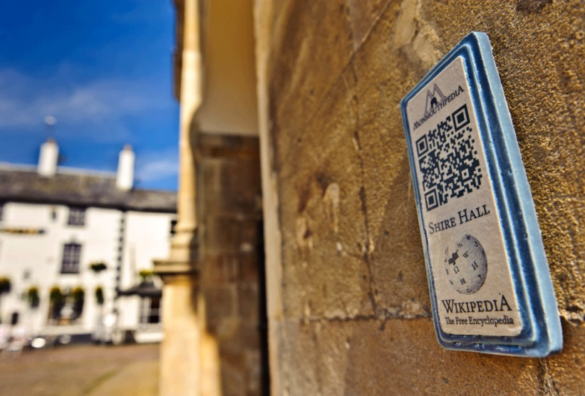
An Innovative example
project: “How to create a Wikipedia Town”
Monmouth the Welsh town created Monmouthpedia;
QRpedia codes all over the town take you to a Wikipedia article in your language.
Ceramic plaque with QRpedia code for Shire Hall.
Blue plaques are used for the Heritage Trail sites
CC BY 2.0
File:QRpedia plaque for Shire Hall, Monmouth.jpg, Created: 11 May 2012
Notes:
Because of Monmouth’s efforts to provide free wi-fi and implement QRpedia, the town is likely the only place where a visitor can tour in Hungarian, Hindi, Indonesian, Welsh, or numerous other Wikipedia languages using QR codes.

Slide 26
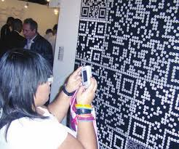
QR Code in Art!
Engaging art with QR technology
Pedro Morales (artist) –
his exhibition in the Galería D'Museo in Caracas, Venezuela.

Slide 27
Tips to make your own
Rules to be considered when using QR Codes in press advertising:
Provide engaging, exciting, rewarding content
Minimise the data content to improve the scanning process
Think about the environment your code is likely to be scanned in
Reproduce the QR Code image at the proper size
Consider the ‘clear zone’ border of the code
Test the scanning process on the material it will be printed on
Explain shortly where the code takes the reader/give instruction
Do ... everything to make the consumer want more!

Slide 28
recourses
https://en.wikipedia.org/wiki/QR_code
http://www.hswsolutions.com/services/mobile-web-development/qr-code-marketing/
http://www.qrcodestickers.org/applications-for-qr-codes/places-where-you-can-find-qr-codes.html
http://deredesycadenas.pedromorales.net/menu-en.htm
http://shambles.net/pages/learning/ict/qrcode/#topofpage
https://qrazystuff.wordpress.com/tag/qr-code/
http://www.hswsolutions.com/services/mobile-web-development/qr-code-marketing/
http://www.emarketservices.com/clubs/ems/prod/E-Business%20Issue%20-QR%20codes%20and%20what%20they%20mean%20for%20eCommerce.pdf
http://cnettv.cnet.com/2001-1_53-50085349.html
http://www.scanlife.com/platform-features/code-actions
http://www.mediaecology.org/publications/MEA_proceedings/v12/4_unlocking.pdf
Rouillard, J. (2008). Contextual QR codes. Proceedings of ICCGI 2008: The third international multi-conference on computing in the global information technology. Athens, Greece: IEEE -pdf resource

Slide 29
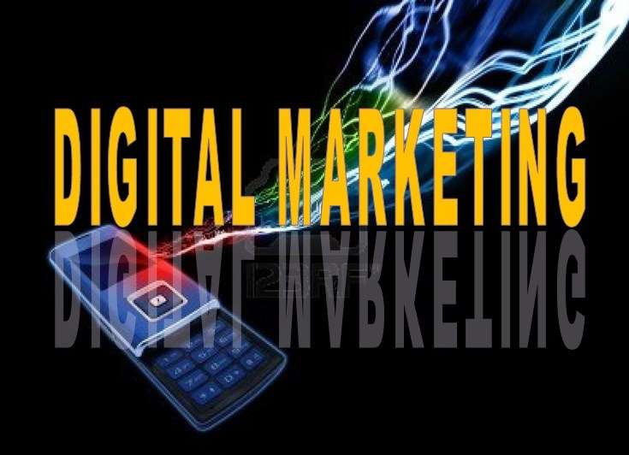
QR CODES
Glykeria Gkouvatsou, Greece

