Slide 1
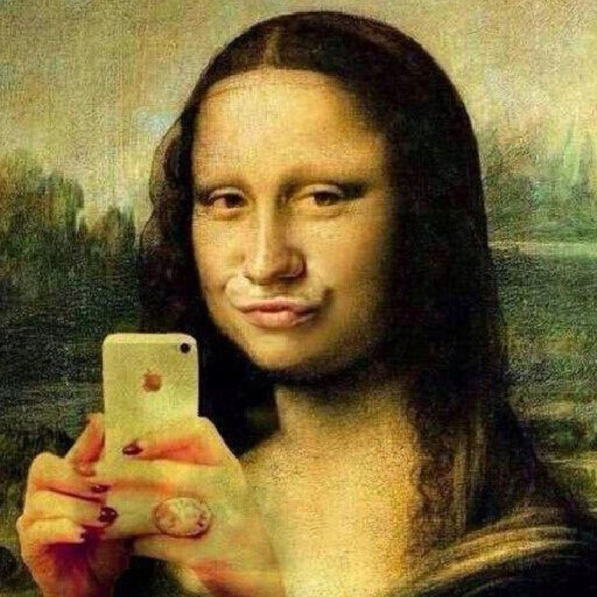
The cult of selfie

Slide 2
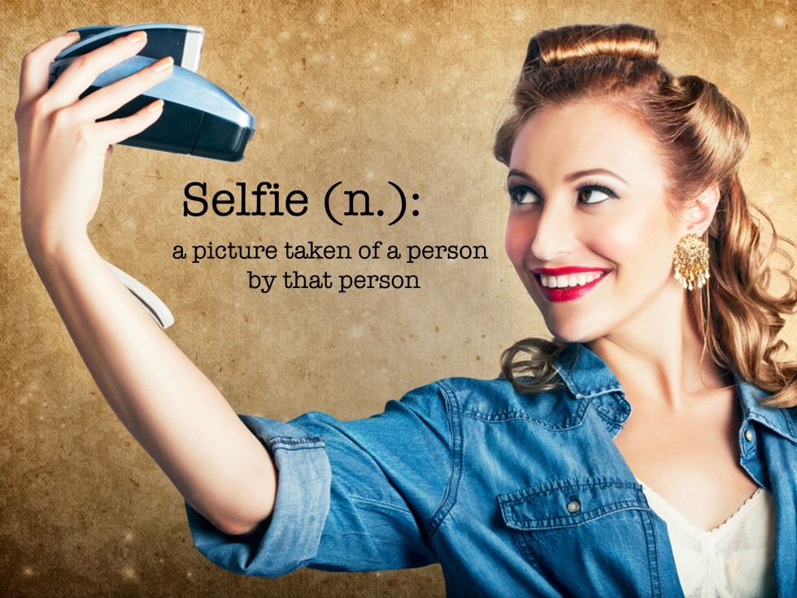
What is a „selfie?
Oxford dictionary:
“a photograph that one has taken of oneself, typically one taken with a smartphone or webcam and uploaded to a social media website.”

Slide 3
Did you know that...?
people upload more than 17 million selfies weekly on social networks,
the use of the word selfie has increased by 17 thousand percent in the English language since 2012,
the word „selfie“ was added to Oxford dictionary in 2013 and was also announced as the word of the year.

Slide 4
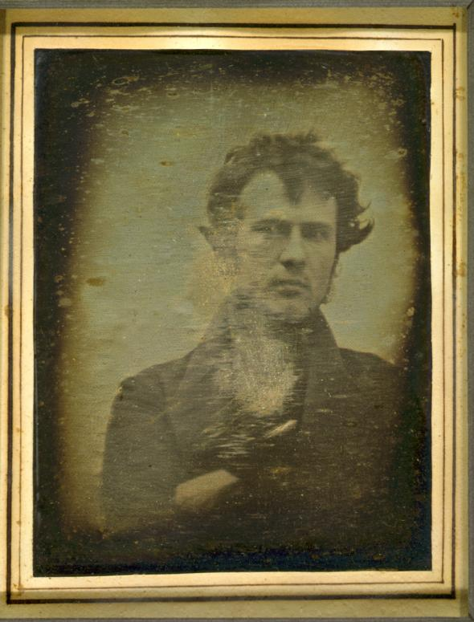
Who´s this man?
Robert Cornelius
The man who took the first ever selfie in 1839

Slide 5
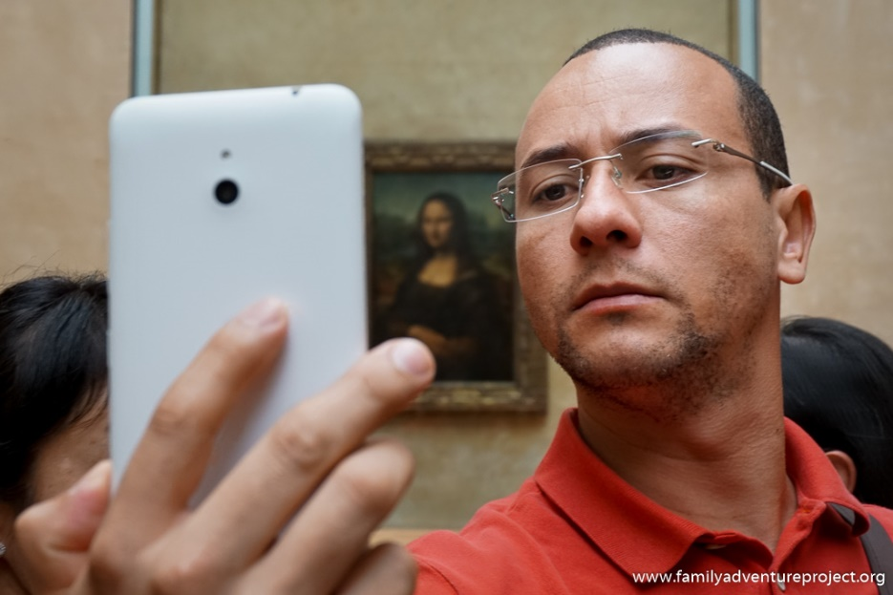
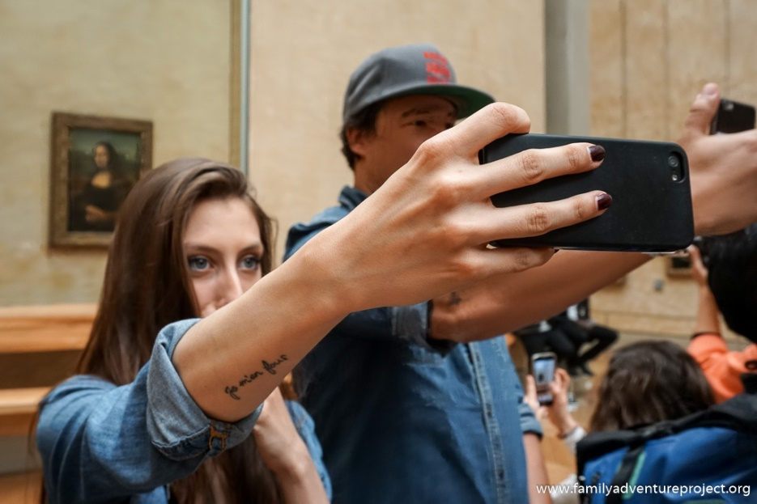
Who´s these pictures about? Mona Lisa? ☹

Slide 6
True or false?
American Psychological Association has confirmed taking selfies to be a mental disorder →
The more time women spend on FB, the more they feel negative about their appearance →
Selfies can say a lot about your personality →
Moscow offers hotline for ‘selfie-addicts’→
Selfies cause car accidents

Slide 7
...and consider this:
India train 'selfie' kills three students →
17-year-old dies in Philippines beach selfie accident →
Selfie crash death: Woman dies in head-on collision seconds after uploading pictures of herself and ‘HAPPY’ status to Facebook →
Man attempts gun selfie, dies by accident →
Tourist falls off 6-foot cliff while taking a selfie in Bali →
Death by selfie stick: man killed by lightning while carrying a selfie stick →

Slide 8
...and what´s more:
SELFIE DANGERS YOU NORMALLY OVERLOOK:
A selfie reveals your location
A selfie gives out personal information
A selfie shows how people look like
A selfie sends the message that „you are not home“
A selfie shows actions people do
A selfie reveals others´ identities
A selfie gives out details about your family
Taking a selfie can become addictive
Taking a selfie can turn deadly
(Taken from: http://nobullying.com/eight-selfie-danger-signs-everyone-should-be-aware-of/)

Slide 9
„The truth about selfies is that once you posted online , you can never control how other people see you.“ Elizabeth Day

Slide 10
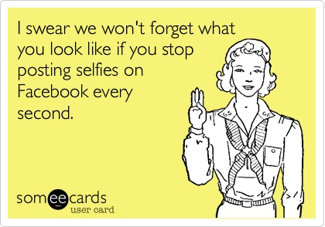
...and by the way...☺

Slide 11
Reference:
www.familyadventureproject.org
Elizabeth Day at http://www.theguardian.com/technology/2013/jul/14/how-selfies-became-a-global-phenomenon
http://publicdomainreview.org/collections/robert-cornelius-self-portrait-the-first-ever-selfie-1839/

